Slide 1




Livestock species and related data
Presentation for Resilient African feed and fodder systems project— 2nd national feed inventory landscape and capacity building workshop
October 30, 2024
John Mutua

Slide 2
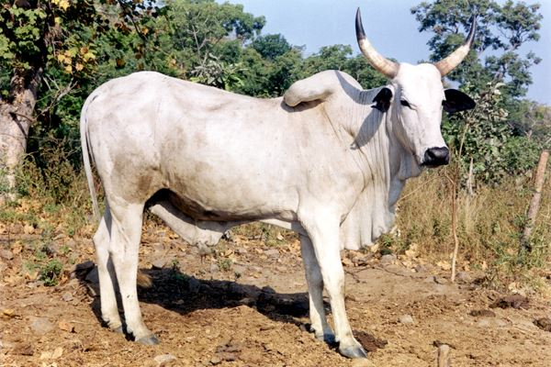
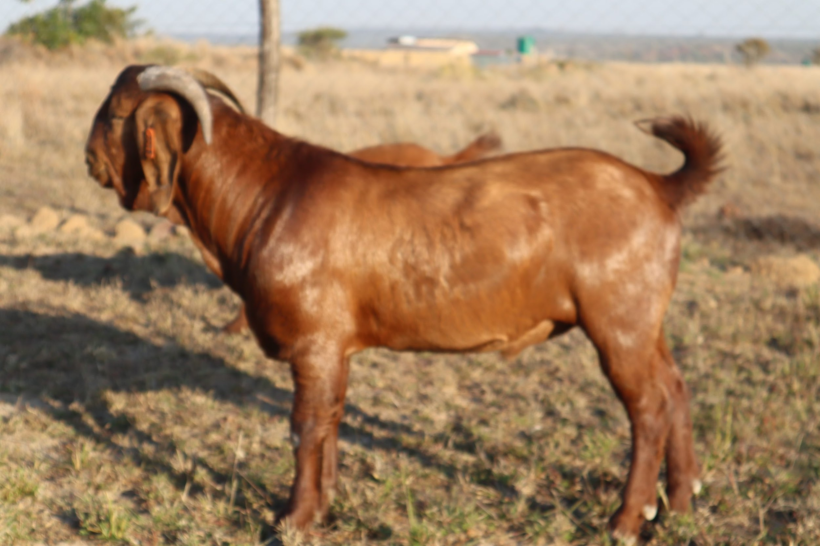
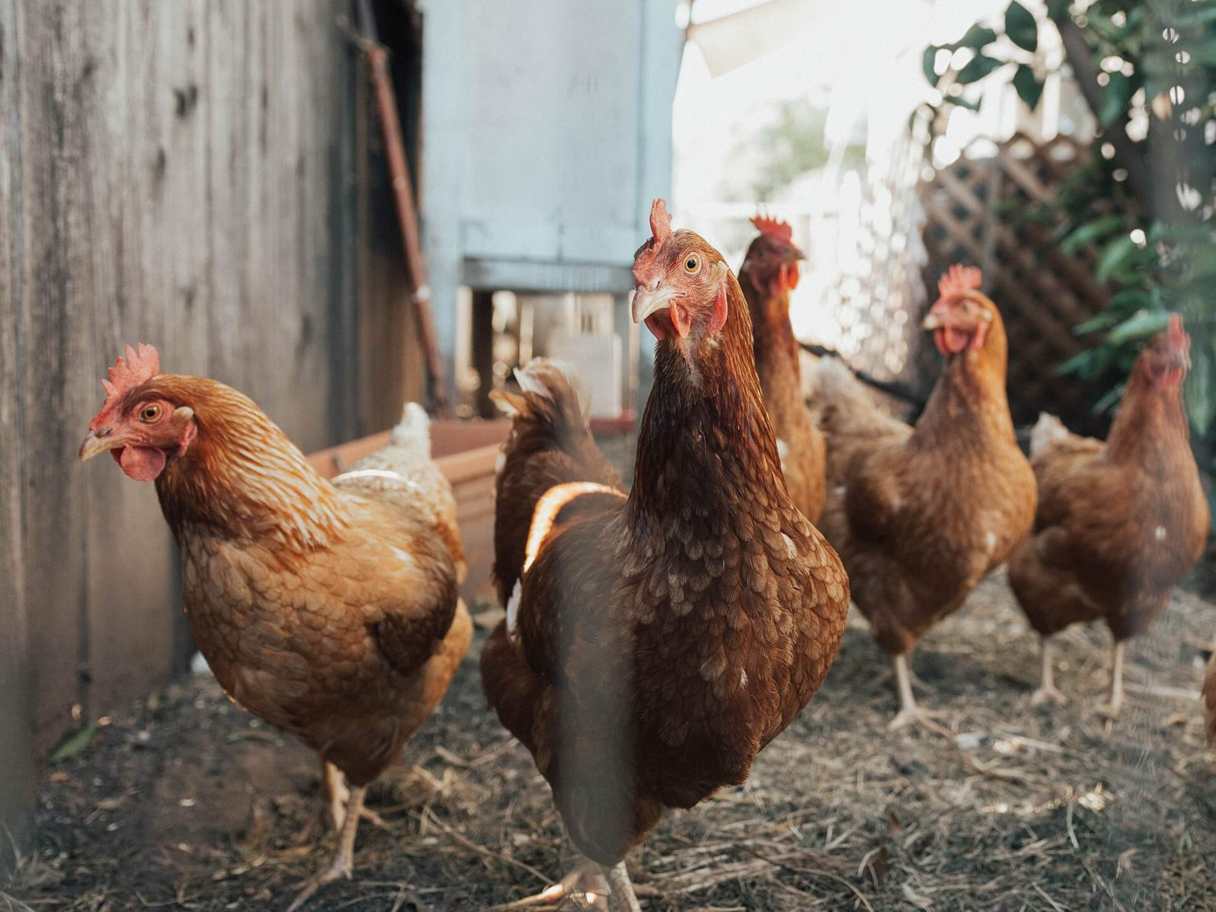
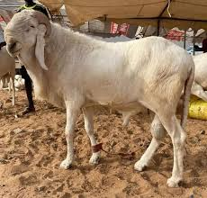
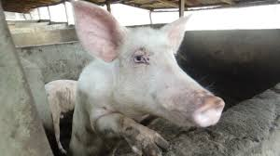
Livestock categories
Expert input
Defining livestock categories

Slide 3
Livestock categories
Bull, Adult males for beef, reproduction or draught power (> 2 years)
Steer, A castrated male cattle early in life primarily raised for beef
Cow, Adult females for producing milk and calves (> 2 years)
Heifer, Replacement females, to replace culled and dead adult females (1-2 years)
Calf, Young male/female (< 1 year)
Sheep (Ram), Adult male sheep that is 1 year or older
. Sheep (Ewe), Adult female sheep that is 1 year or older
Lamb, Sheep that is less than one year old
Goat (Buck), Adult male goat that is 1 year or older
Goat (Doe), Adult female goat that is 1 year or older
Kid, Goat that is less than one year old

Slide 4
Parameters - By season and zone
Herd structure, %
Live weight, Kilogram
Age, Years
Daily weight gain, Kilogram
Fertility rate, %
Lactation length, Days
Daily milk yield, Kilogram
Annual milk yield, Kilogram
Daily walking distance, Kilometer
Proportion of population used for draught , %

Slide 5
Task
List livestock categories
Indicate parameters per livestock category, season and zone
NB: The more the samples the better

Slide 6
Thank you

